Slide 1

FlowerNest-Flower catalogue App Design
Sindhu Kodihal

Slide 2
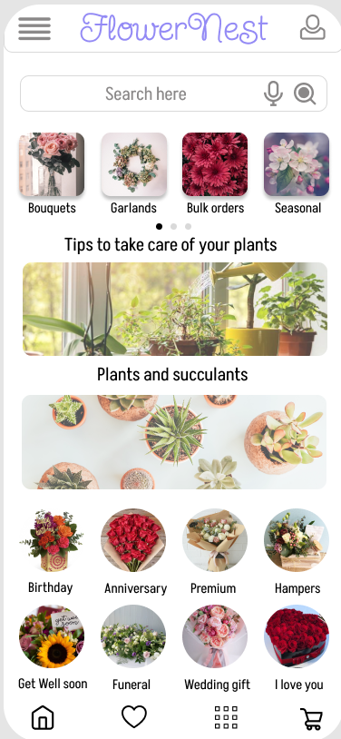
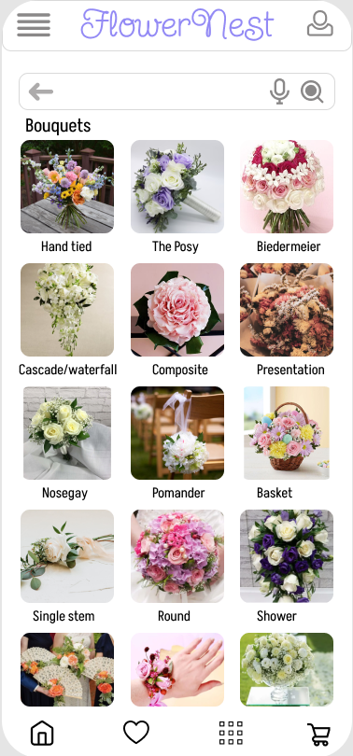
Project overview
The product:
FlowerNest is a flower catalogue app for a local florist located in a Metropolitan city. This app strives to deliver freshly cut and seasonal flowers, Bouquets, garlands for a wide variety of events. FloweNest allows customers to place bulk orders for events well in advance.
Project duration:
February – March 2023

Slide 3
Project overview
The problem:
When it comes to purchasing and delivering flowers, it can often be a struggle to find the time to do it, especially on special occasions like birthdays and anniversaries.
The goal:
The goal is to make the process of buying and delivering flowers as easy and convienent as possible for those who have a busy schedule.
Provide a convienent and customisable solution for users to send flowers to their loved ones on special occassions.

Slide 4
Project overview
My role:
UX Designer designing an app for FlowerNest from conception to delivery.
Responsibilities:
Conducting interviews, paper and digital wireframing, low and high-fidelity prototyping, conducting usability studies, accounting for accessibility, and iterating on designs.

Slide 5
User research
Personas
Problem statements
User journey maps
Understanding
the user

Slide 6
User research: summary
I conducted interviews and created empathy maps to understand the users I’m designing for and their needs. A primary user group identified through research was working adults who don’t have time purchase and deliver flowers especially on occasions like birthdays and anniversaries.
This user group confirmed initial assumptions about FlowerNest customers, but research also revealed that time was not the only factor limiting users from going out and purchasing flowers. Other user problems included obligations, interests, or challenges that make it difficult to go out and buy flowers or rather buy flowers in advance for any sort of event.

Slide 7
User research: pain points
1
2
3
4
Time
Navigation
Assistive technology
Visual appeal
Working adults are too busy to go out and spend time on picking up the right bouquet.
If the app has large number of categories, it may lead to user confusion and frustration.
Platforms for ordering flowers are not equipped with assistive technologies
.
If the app doesn’t have visually appealing images and catalogues, users may not be motivated to browse or make purchase. This may lead to low sales.

Slide 8
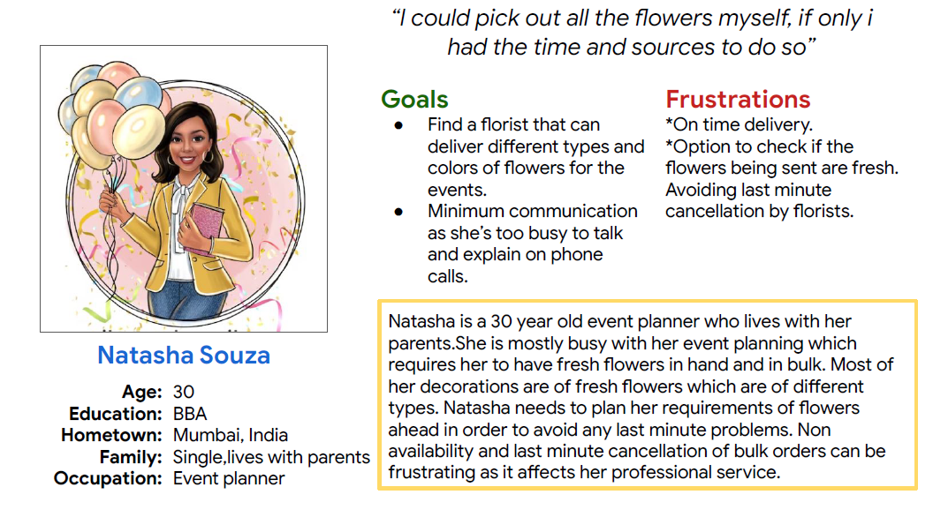
Persona: Natasha
Problem statement:
Natasha is an event planner of a very big event management company in Mumbai. She wants to order and review fresh flowers in advance for decorations and set up so that there are no dull and dead flowers at the time of event.

Slide 9
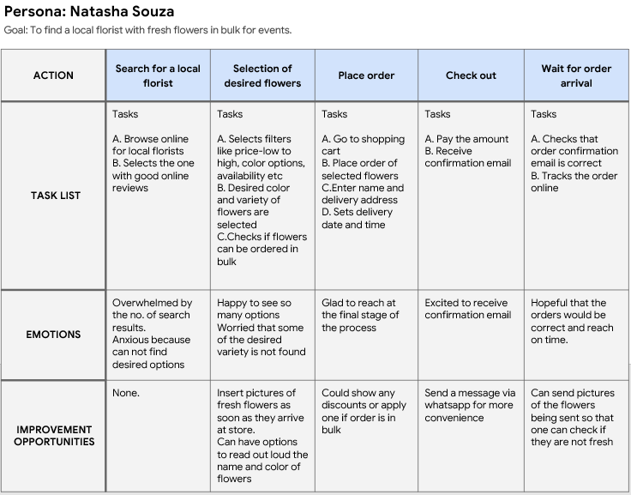
User journey map
Mapping Natasha’s user journey revealed how helpful it would be for users to have access to a dedicated FlowerNest app.
Image of user journey map

Slide 10
Paper wireframes
Digital wireframes
Low-fidelity prototype
Usability studies
Starting
the design

Slide 11
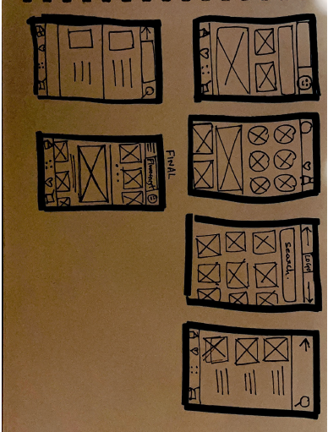
Paper wireframes
Taking the time to draft iterations of each screen of the app on paper ensured that the elements that made it to digital wireframes would be well-suited to address user pain points. For the home screen, I prioritized a quick and easy ordering process to help users save time.
This here is an example of how I came to design the homescreen of the app
Image of paper wireframes including five different versions of the same screen and one image of the new, refined version

Slide 12
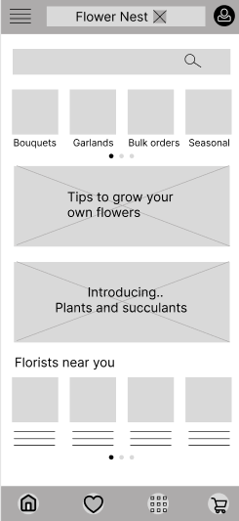
This button here helps users to search any item easily from the homepage
Digital wireframes
This buttons makes it easier to chose from many options available.
As the initial design phase continued, I made sure to base screen designs on feedback and findings from the user research.
This is an additional button on the homescreen.
Insert first wireframe example that demonstrates design thinking aligned with user research

Slide 13
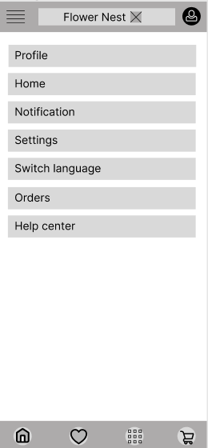
Digital wireframes
Easy access to navigation that’s screen reader friendly.
Easy navigation was a key user need to address in the designs in addition to equipping the app to work with assistive technologies.
Insert second wireframe example that demonstrates design thinking aligned with user research

Slide 14
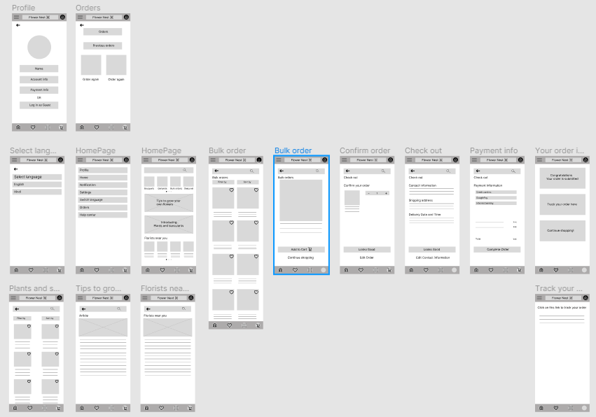
Digital
wireframes

Slide 15
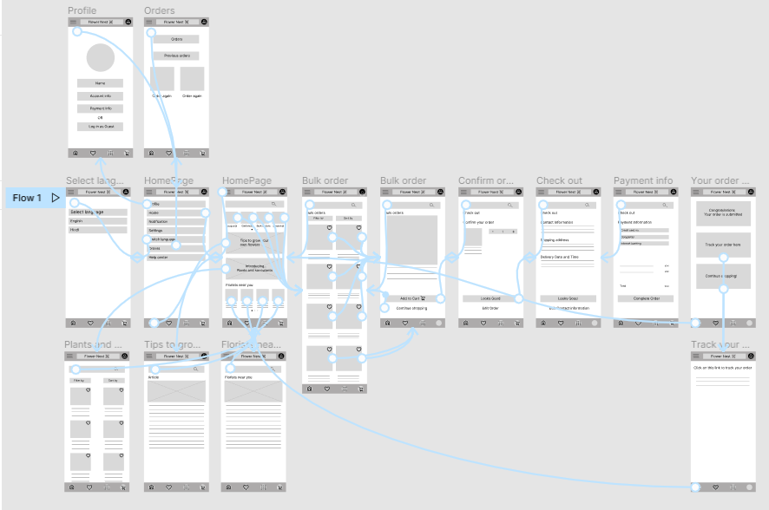
Low-fidelity
prototype
Low fidelity prototype was created after completing a set of digital wireframes. I have shown one of the user flows here i.e. ordering flowers in bulk. The process of checkout is easy and simple and is the same for any other bouquets and garlands.
View FlowerNest’s
Low Fidelity Prototype

Slide 16
Usability study : findings
I conducted two rounds of usability studies. Findings from the first study helped guide the designs from wireframes to mockups. The second study used a high-fidelity prototype and revealed what aspects of the mockups needed refining.
Round 1 findings
Round 2 findings
users need an option where they can add or
subtract each item from their cart
Users are not clear about selecting date and time.
1
1
users might like it if we introduce google pay
option
2
introduce an option where users go back to
homepage after order confirmation.
3
4
Users need option to log in as guest

Slide 17
Refining
the design
Mockups
High-fidelity prototype
Accessibility

Slide 18
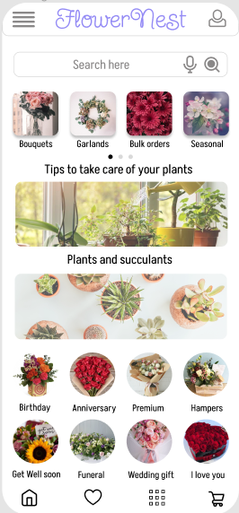
Before usability study
After usability study
Mockups
After the usability study I revised the design and now users can see all the categories of flowers when they first land on the home screen.
Image of selected screen after usability study

Slide 19
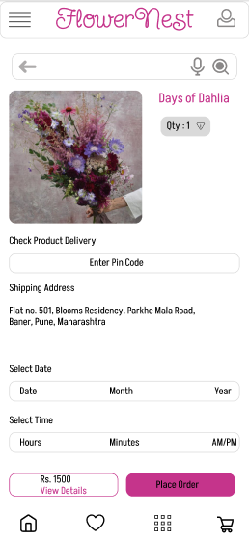
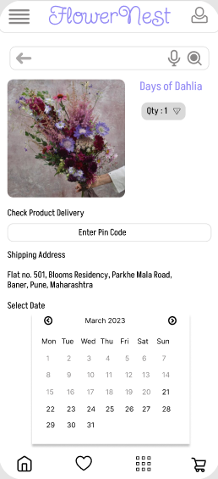
Before usability study
After usability study
Mockups
The second usability study revealed that users had problem selecting date and time of delivery.
To solve this I added calendar option and time options from 9am-12 noon, 12 noon – 4pm, 4pm – 7 pm.

Slide 20
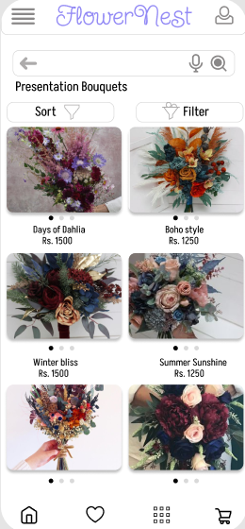
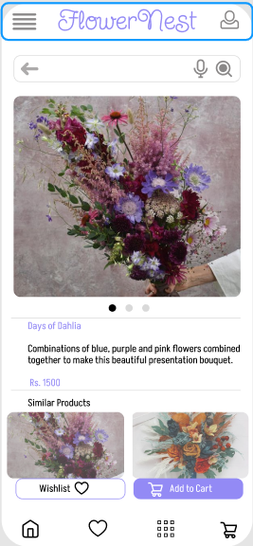
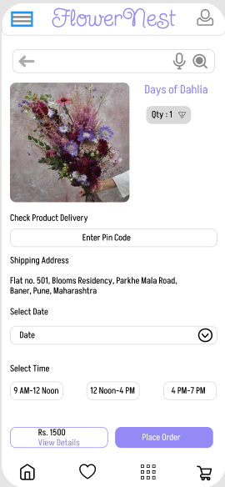
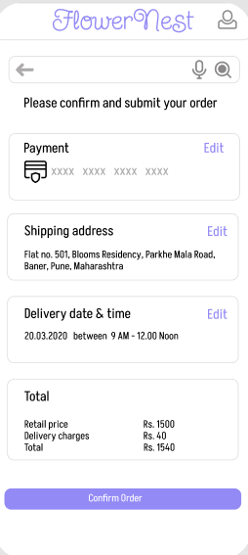
Mockups

Slide 21
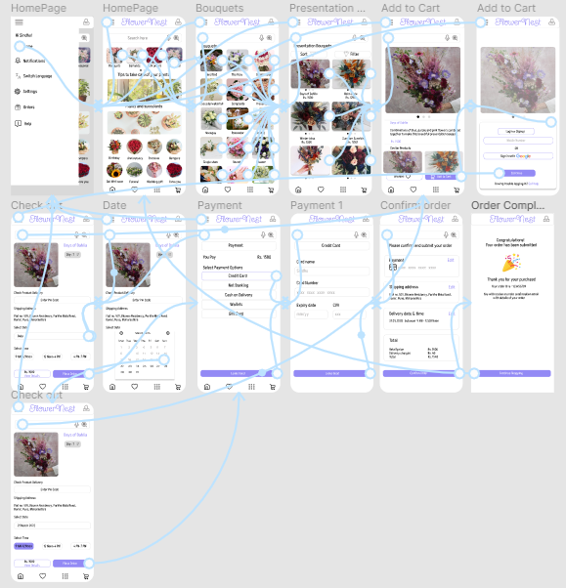
High-fidelity prototype
The final high-fidelity prototype presented cleaner user flows for selecting flowers and checkout.
View FlowerNest’s
High Fidelity prototype

Slide 22
Accessibility considerations
1
2
3
Provided access to users who are vision impaired through adding alt text to images for screen readers
Used icons to help make navigation easier.
Used detailed imagery for flowers and bouquets to help all users better understand the designs.

Slide 23
Going forward
Takeaways
Next steps

Slide 24
Takeaways
Impact:
The app makes users feel FlowerNest really thinks about how to meet their needs.
One quote from peer feedback:
“I would definitely use FlowerNest App because it seems intuitive and easy to use.”
What I learned:
While designing the flower catalogue app, I learned that the first ideas for the app are only the beginning of the process.
I also learned that the App is never complete, we get new ideas and feedback every now and then which ultimately leads to a more improvised product.
Usability studies and peer feedback played an important role in each iteration of the app’s designs.

Slide 25
Next steps
1
2
Conduct another round of usability studies to validate whether the pain points users experienced have been effectively addressed..
Conduct more user research to determine any new areas of need.

Slide 26
Insert a few sentences summarizing the next steps you would take with this project and why. Feel free to organize next steps in a bullet point list.
Let’s connect!
Thank you for your time reviewing my work on the FlowerNest app! If you’d like to see more or get in touch, my contact information is provided below.
Email: sindhukodihal15@gmail.com
Website:

